Slide 1



Distributed Stream Processing Using SAMOA Framework
Li Huang
Advisor: Dr. Mehmed Kantardzic
Master of Computer Science
Final Project Presentation
University of Louisville
April 25,2014
SAMOA Framework

Slide 2
Outline
Introduction
What is SAMOA
Project proposal
Experiment 1: Test Performance of SAMOA
Test default algorithm in cluster environment
Experiment 2:Develop data mining algorithm in SAMOA
Implement Naive Bayes classify algorithm
Conclusion and Future Work
Experience
Parallel Naive Bayes Classifier
Demo: Classification with SAMOA
SAMOA Framework

Slide 3


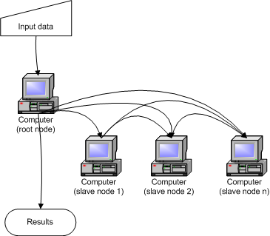
What is SAMOA
Scalable Advanced Massive Online Analysis
developed by Yahoo Research Barcelona, Oct. 2013.
Environment
A Framework for
Mining
Big Data Streams
in a Cluster environment
SAMOA Framework

Slide 4
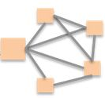

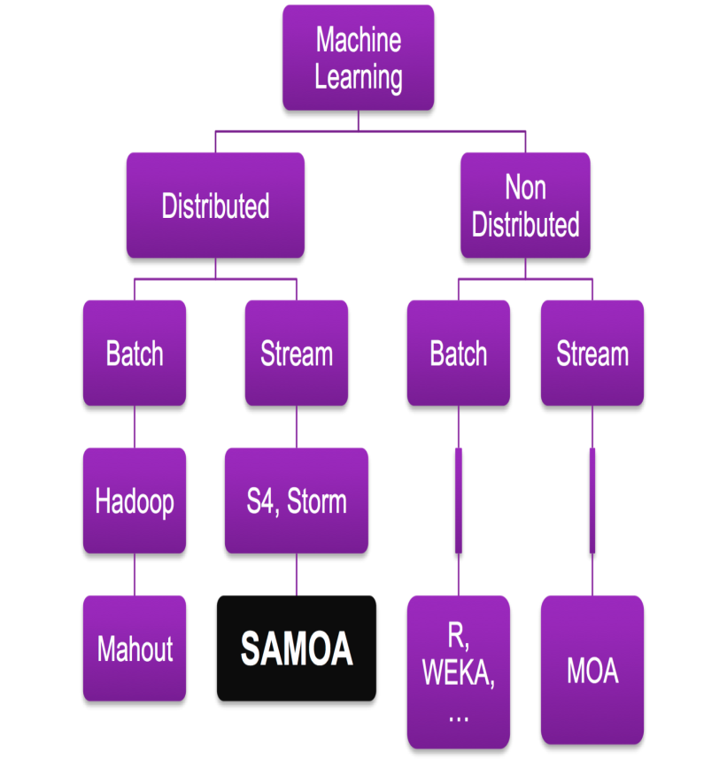
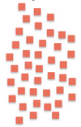





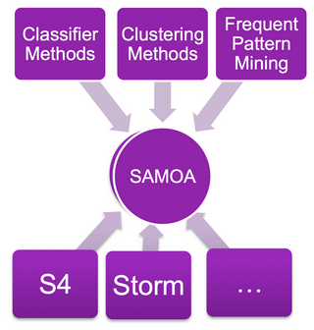

Purpose of SAMOA
Challenge
Solution
Relation with other data mining platforms
Big Data
Volume
high amount, maybe infinite
Velocity
high speed of arrival
Variety
multi-sources &formats
concept drift
Tasks
Classification, Clustering, Prediction, Association …
Examples
Spam detection in comments on Yahoo News.
Trends change in time.
Distributed data mining platform
Input data
Analytics
Batch Platforms
Stream Platforms
MapReduce
Stream Data →Online Algorithms
SAMOA = Distributed stream process platform + Data mining tools
SAMOA Framework
Notes:
Stream data:
1.Unbounded size, maybe infinity 2.Data not in order 3. discarded after being used 4. evolving

Slide 5
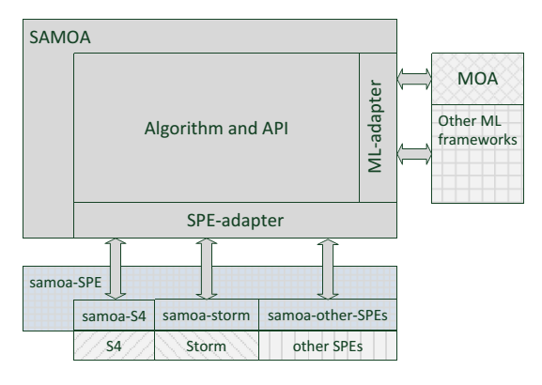
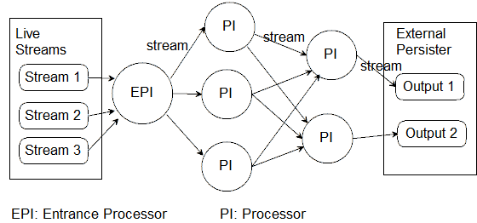
Process and programming model
Architecture
Programming Model
SAMOA Framework

Slide 6
Advantages and Disadvantages
Advantages:
Simple and flexible programming model.
Write algorithm code once, run on all supported stream process engines(SPEs --S4 & Storm).
Can extends to adapt other SPEs.
Real time stream data, distributed computing
Disadvantages:
Just beginning, version 0.0.1.
Lack of documents and supports. A few bugs.
Few algorithms are integrated so far.
(Vertical Hoeffding Decision Tree Classifier; CluStream clustering algorithm)
Low automation: Need complex manual configurations and command lines to setup and run; Text output, Lack of GUI Tools.
*Do not have module which reads data from Internet so far. Need user to develop.
Project Proposal:
Check how easy/hard to setup and use SAMOA.
Test its performance and scalability for cluster.
Test its expandability to support user-defined algorithms.
SAMOA Framework

Slide 7
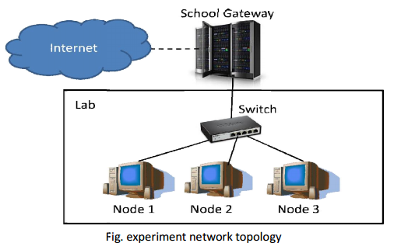
Experiment 1- Performance Test
Goal:
Test performance(speed) of SAMOA on cluster environment, and check whether it runs faster with more computing nodes.
Task
Classify the instances with Vertical Hoeffding Decision Tree.(VHT)
Dataset
Randomly generated (by SAMOA) data.
Online training/test, all instances are test first then used to train the classifier.
Measurement
Total running time.
Dataset | Number of Instances | Attributes
Small | 100,000 | 10 nominal. 10 numeric.
Medium | 500,000 | 10 nominal. 10 numeric.
Medium -large attributes | 100,000 | 50 nominal. 50 numeric.
Environment
node1: P4 1.8, 576M ram node2: P4 1.8, 768M ram node3: P4 2.35, 495M ram
Ubuntu 12.04 desktop 32-bit Yahoo S4 0.6
SAMOA Framework

Slide 8
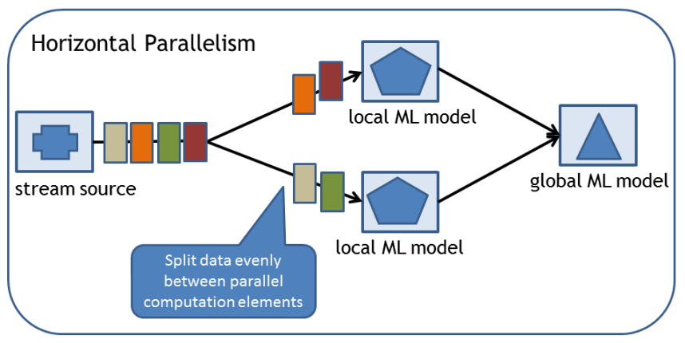
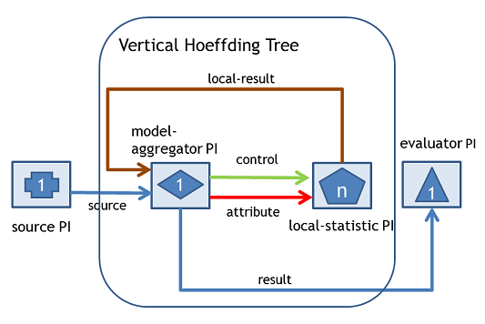
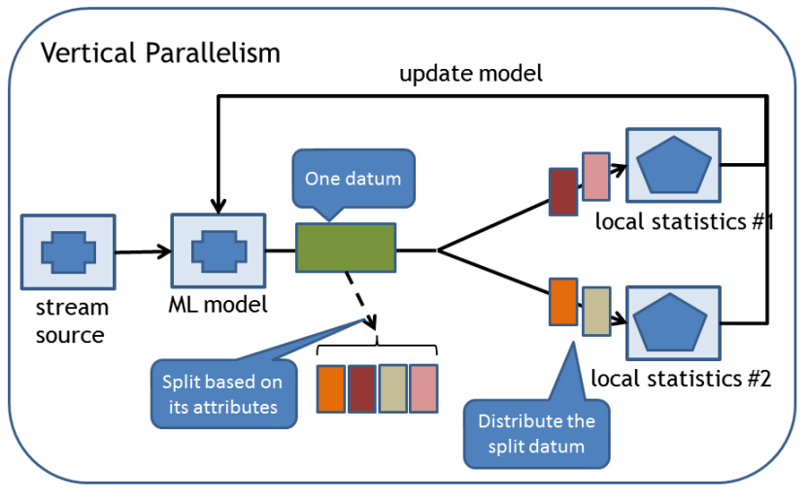
Experiment 1- Vertical Hoeffding Tree
SAMOA Framework

Slide 9
Experiment 1- Result
Conclusion:
Local mode is always the fastest way in the test.
In cluster mode:
Only with “medium” dataset, the classification speed increases with more nodes.
With other dataset, 2-nodes configuration increase the classification speed than 1-node, but 3 nodes decrease the speed.
*VHT: Vertical Hoeffding Tree
SAMOA Framework

Slide 10
Experiment 2- Develop data mining algorithm in SAMOA
Goal:
learn how to implement user-defined data mining algorithm under SAMOA platform, I tried to implement a Naive Bayes Classifier.
Task
Implement a Naive Bayes algorithm in SAMOA.
Classify the instances with this Navie Bayes algorithm.
Compare speed and correct rate with Vertical Hoeffding Decision Tree.
Dataset
Movie Review Data
Kdd99
Nsl Kdd99
Online training/test, all instances are test first then used to train the classifier.
Measurement
Classification speed (second/1000 instances).
Correct rate (%).
Environment and Configurations
Same as Experiment 1.
Datasets
Movie Review Data
Kdd99
NSL-Kdd99
Cluster Configurations
1 node(local)
1 node (S4)
2 nodes (S4)
3 nodes (S4)
Algorithms
Naive Bayes (NB-5)
Vertical Hoeffding Tree (VHT)
Bagging-NB5
Bagging-VHT
*NB-5: the 5th version of my Naive Bayes Classifier design. The previous versions have some problems, so are not shown.
SAMOA Framework

Slide 11
Experiment 2-Datasets
Data | Total instance number | Attribute Number | Class Number | Note
Movie Review | 2000 | 1172 | 2 | 50% pos 50% neg
NSL Kdd99 | 125,973 | 42 | 2 | Unbalance
Kdd99 | 4,898,431 | 42 | 23 | Unbalance. Contains error values
Nsl-Kdd99:
anomaly-87%
normal-14%
Kdd99:
smurf-87%
neptune- 12%
normal-0.48%
Movie Review:
Collections of movie-review documents labeled with respect to their overall sentiment polarity (positive or negative)
Kdd 99:
Network attacks. Each instance is a network connection record. The class label is “normal” connection or 22 types of attacks.
NSL-Kdd 99:
Improvement of Kdd 99. Remove redundant records and transforms class labels into only two types, “anormaly” and “normal”.
SAMOA Framework

Slide 12







Experiment 2-Naive Bayes Algorithm
Naive Bayes Classifier
Consider the input data instance, has m attributes X=(x1,x2,..., xm)
It may belong to K classes C1,C2,…CK.
P(Ck|X): Probability that X belongs to class k.
Find the class Ck which has maximum P(Ck|X).
Bayes rule
Independent assumption
Estimate class label
Probability Estimation
N: totally number of training instances.
N(c): number of instances in training data that belongs to class c.
N(xi,c): number of instances has value xi in attribute i, and belongs to class c.
I, J: user defined variable for smoothing, usually I=1. J= number of distinct values of attribute i
: variance of the values in associated with class c
: mean of the values in associated with class c
When xi is nominal attribute
When xi is numeric attribute
SAMOA Framework

Slide 13
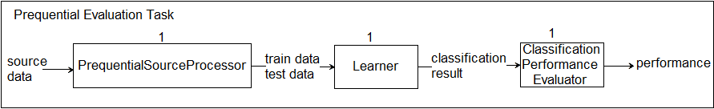
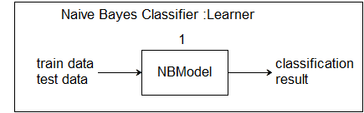
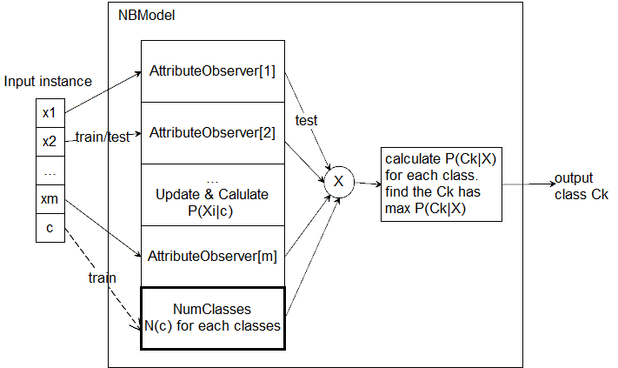
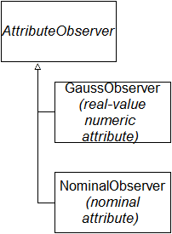
Experiment 2-Naive Bayes Classifier
SAMOA Framework

Slide 14
Experiment 2-Result
SAMOA Framework

Slide 15
Experiment 2-Conclusion
Performance
Problems
Speed:
NaiveBayes is faster than VHT.
Bagging is slower than non-bagging algorithm.
Correct rate:
NaiveBayes has higher correct rate than VHT.
Bagging is similar as non-bagging algorithms.
Compatability:
NaiveBayes(version 5) can ignore error data.
With more nodes, the classification speed did not increase, but decreased with more nodes.
Current Naive Bayes Classifier is non-parallel structure.
The whole input data are taken for training .
SAMOA Framework

Slide 16
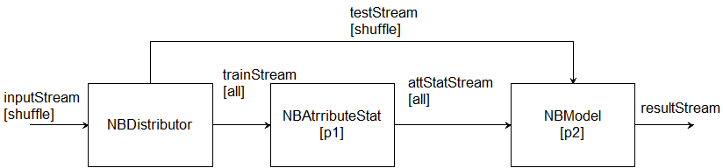
Conclusion and future work
Experience:
The speed in most tests did not increase when cluster scaled up. Possible reasons:
Low data throughput.
Take more time on sending messages in network than computing.
Unbalanced hardware of nodes.
If the data throughput is not very large, distributed computing is not worth because the speed might decrease. SAMOA is useful only for Big Fast data & evolving data.
SAMOA is very primitive so far, need much further improvement.
I learnt how to create a computing cluster, and get familiar with a tool to do distributed stream data mining. And also, I learnt how to implement a distributed learning algorithm for stream data mining.
Demo !
Future work:
Data Splitter: 20% training, 80% testing
Parallel Naive Bayes.
SAMOA Framework

Slide 17

Looking forward to your
Questions
Suggestions
Comments
SAMOA Framework

